Slide 1
VARIATIONS
Dec 2019
Thanks for many PPT and Tutorials

Slide 2
Outline
Types of genetic variation
Framework for variant discovery
Variant calling methods and variant callers
Filtering of variants
Structural variants

Slide 3
Some definitions
Different versions of the same variant are called alleles such as C / T
reference allele refers to the base that is found in the reference genome. It is not always the major allele.
alternative allele refers to any base, other than the reference. The alternative allele is not necessarily the minor allele. There can be more than one alternative allele per variant.
haplotypes are blocks in the genome with alleles at variants tend to occur together more often than is expected by chance.
Linkage disequilibrium (LD) is a measure of how often two alleles or specific sequences are inherited together.

Slide 4
Human genome
whole genome sequences at 30x to 50x depth of coverage.
For a typical individual:
2.8 billion base pairs are sequenced
~3-4 million single nucleotide variants
~600,000 insertions/deletions (SNPs)
We try to sequence mother/father/child trios
whole exome sequencing
For a typical individual:
60 million base pairs are sequenced
There are ~80,000 variants
There are ~11,000 nonsynonymous SNPs

Slide 5
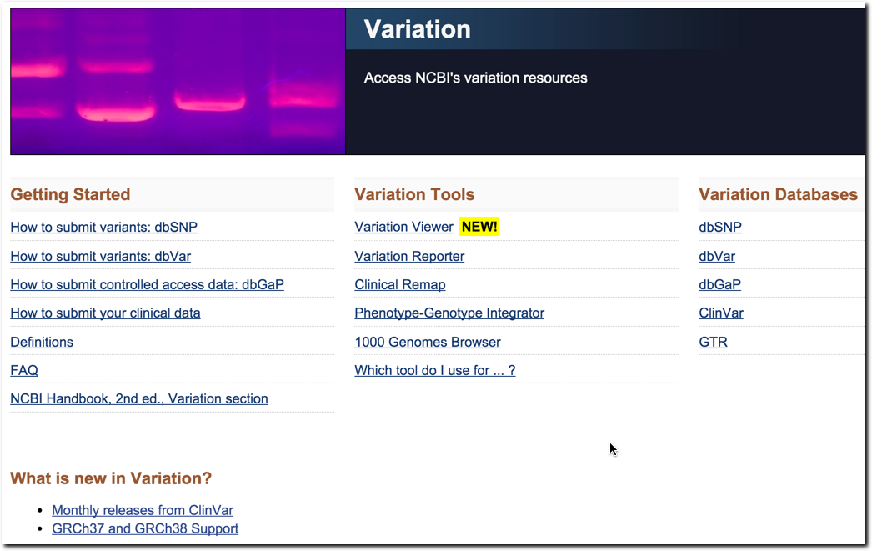
Variation Home Page
www.ncbi.nlm.nih.gov/variation
Glossary
How does NCBI calculate clinical significance?

Slide 6
Types of Genetic Variation
Cancer is driven by genomic alterations like:
Single Nucleotide Aberrations
Single Nucleotide Polymorphisms (SNPs) - mutations shared amongst a population
Single Nucleotide Variations (SNVs) - private mutations
Short Insertions or Deletions (indels)

Slide 7
SNPs vs. SNVs
Both are aberrations at a single nucleotide
SNP
Aberration expected at the position for any member in the species (well-characterized)
Occur in population at some frequency so expected at a given locus
Validated in population (>=1%)
Catalogued in dbSNP (http://www.ncbi.nlm.nih.gov/snp)
SNV
Aberration seen in only one individual (not well characterized)
Occur at low frequency so not common
Not validated in population
Really a matter of frequency of occurrence

Slide 8
SNVs of interest
Non-synonymous mutations
Result in amino acid change
Impact protein sequence
Missense, nonsense, stop gained/lost mutations
Non-coding region
Result in TF binding (gain loss)
Splicing effect..
Somatic mutations in cancer
Tumor-specific mutations

Slide 9
Catalogs of human genetic variation
The 1000 Genomes Project
http://www.1000genomes.org/
SNPs and structural variants from 2500 individuals from about 25 populations
HapMap
http://hapmap.ncbi.nlm.nih.gov/
identify and catalog genetic similarities and differences
dbSNP
http://www.ncbi.nlm.nih.gov/snp/
Database of SNPs and multiple small-scale variations
COSMIC
http://www.sanger.ac.uk/genetics/CGP/cosmic/
Catalog of Somatic Mutations in Cancer
TCGA
http://cancergenome.nih.gov/
The Cancer Genome Atlas researchers are mapping the genetic changes in 20 selected cancers
ClinVar
http://www.ncbi.nlm.nih.gov/clinvar/
aggregates information about sequence variation and its relationship to human health

Slide 10
A “case study” in Cancer Research
TCGA (project focused on ‘variations’)
Why call variants? SOMATIC vs GERMLINE
There are at least 200 forms of cancer, and many more subtypes. Each of these is caused by errors in DNA that cause cells to grow uncontrolled.
the foundation for improving cancer prevention, early detection and treatment.”

Slide 11
Challenges of accurate somatic variant calling
Not as simple as identifying sites with a variant allele in the tumor not present in the normal
Artifacts from PCR amplification or targeted (exome) capture
Machine sequencing errors
Incorrect local alignment of reads
Tumor heterogeneity
Tumor-normal cross-contamination

Slide 12
variant calling
three step process:
Carry out whole genome or whole exome sequencing to create FASTQ files.
Align the sequences to a reference genome, creating BAM or CRAM files.
Identify where the aligned reads differ from the reference genome and write to a VCF file.

Slide 13
Variant calling methods
> 15 different algorithms
Three categories
Allele counting
Probabilistic methods, e.g. Bayesian model
to quantify statistical uncertainty
Assign priors based on observed allele frequency of multiple samples
Heuristic approach
Based on thresholds for read depth, base quality, variant allele frequency, statistical significance
SNP
variant
Ref
A
Ind1
G/G
Ind2
A/G
Nielsen R, Paul JS, Albrechtsen A, Song YS. Genotype and SNP calling from next-generation sequencing data. Nat Rev Genet. 2011 Jun;12(6):443-51. PMID: 21587300.

Slide 14
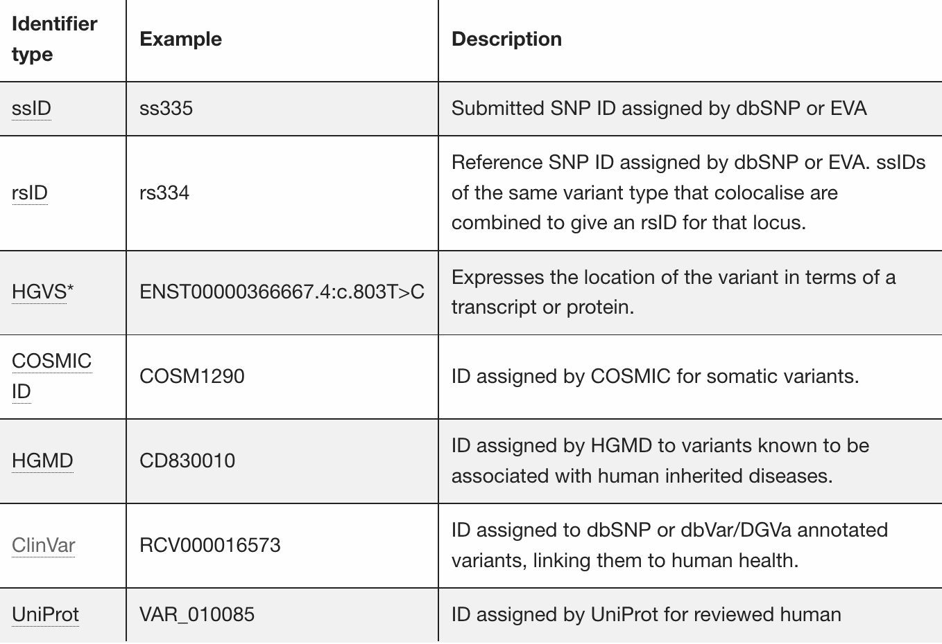
Variants (different) identifiers

Slide 15
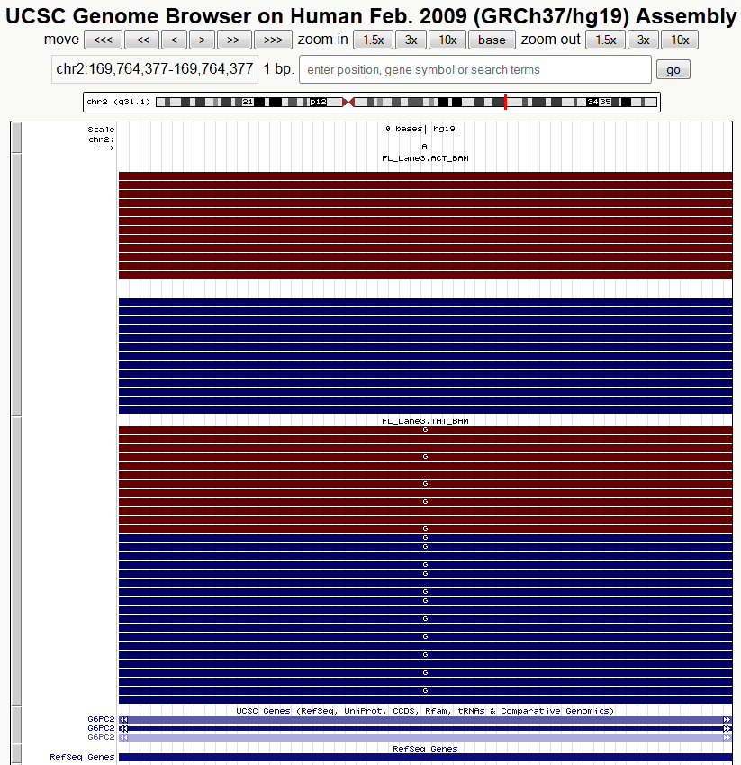
REF allele
G6PC2
hg19
chr2:169764377
A>G Asn286Asp
Normal
Depth=25
REF=25
ALT=0
Tumor
Depth=31
REF=15
ALT=16

Slide 16
Allele Counting Example
JointSNVMix & VarScan2 (Fisher’s Exact Test)
Allele count data from the normal and tumor compared using a two tailed Fisher’s exact test
If the counts are significantly different the position is labeled as a variant position (e.g., p-value < 0.001)
2x2 Contingency Table
 | REF allele | ALT allele | Total
Tumor | 15 | 16 | 31
Normal | 25 | 0 | 25
Totals | 40 | 16 | 56
G6PC2
hg19
chr2:169764377
A>G Asn286Asp
The two-tailed for the Fisher’s Exact Test p-value is < 0.0001
The association between rows (groups) and columns (outcomes) is considered to be extremely statistically significant.

Slide 17
Allele Counting - What for
GWAS experiments are designed to compare the frequency of variants in cases (individuals with the phenotype) than controls (individuals without the phenotype).
Statistical analysis is carried out to indicate how likely a variant is to be associated with a trait.

Slide 18
Types of Genetic Variation –more
Copy Number Variations (CNVs)
Larger Structural Variations (SVs)

Slide 19
Why study Structural Variation (SV)
Common in “normal” human genomes - major cause of phenotypic variation
Common in certain diseases, particularly cancer
Now showing up in rare disease; autism, schizophrenia
Zang, Z.J. et al. Genetic and Structural Variation in the Gastric Cancer Kinome Revealed through Targeted Deep Sequencing. Cancer Res January 1, 71; 29 (2011).
Shibayama, A. et al. MECP2 Structural and 30-UTR Variants in Schizophrenia, Autism and Other Psychiatric Diseases: A Possible Association With Autism. American Journal of Medical Genetics Part B (Neuropsychiatric Genetics) 128B:50–53 (2004).

Slide 20
Task 2
All known variants
Gene(s) of interest
Molecular consequence?
Gene
ClinVar
Clinical significance?

Slide 21
ClinVar www.ncbi.nlm.nih.gov/clinvar
Archive of interpretations of variants relative to conditions
Variant-level information
Fully public and freely available
Submission-driven database
Curation support from NCBI staff

Slide 22
ClinVar integrates four domains of information
Variation
Condition
Interpretation
Evidence
Notes:
determinants of value

Slide 23
What is ClinVar? ClinVar is a freely accessible, public archive of reports of the relationships among human variations and phenotypes… ClinVar processes submissions reporting variants found in patient samples, assertions made regarding their clinical significance,
ClinVar

Slide 24
Key features in ClinVar ClinVar supports submissions of differing levels of complexity. E.g. - a representation of an allele (termed a variant-level submission), -multiple types of structured observational (case-level) - experimental evidence about the effect of the variation on phenotype.

Slide 25
Key features in ClinVar ClinVar is an active partner of the ClinGen project (curation) Reflect both consensus and conflicting assertions of clinical significance ClinVar neither curates content nor modifies interpretations independent of an explicit submission.

Slide 26
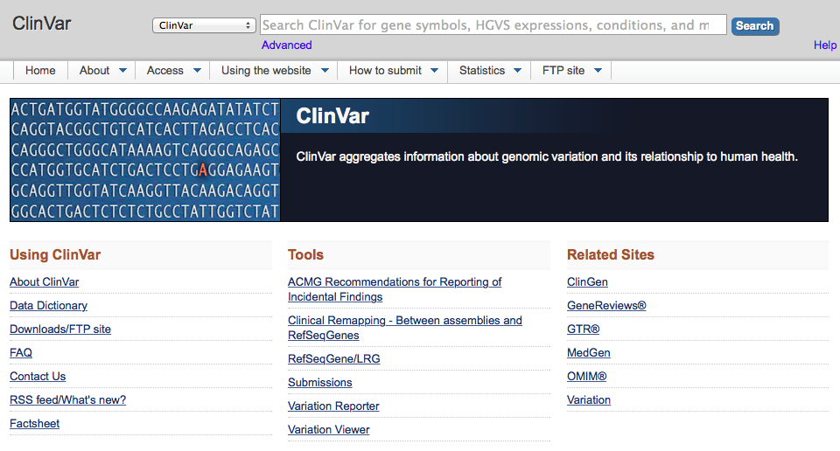
NCBI tools to understand variation: (2) ClinVar
http://www.ncbi.nlm.nih.gov/clinvar/
ClinVar: “A resource to provide a public, tracked record of reported relationships between human variation and observed health status with supporting evidence. Related information in the NIH Genetic Testing Registry (GTR), MedGen, Gene, OMIM, PubMed and other sources is accessible through hyperlinks on the records.”

Slide 27
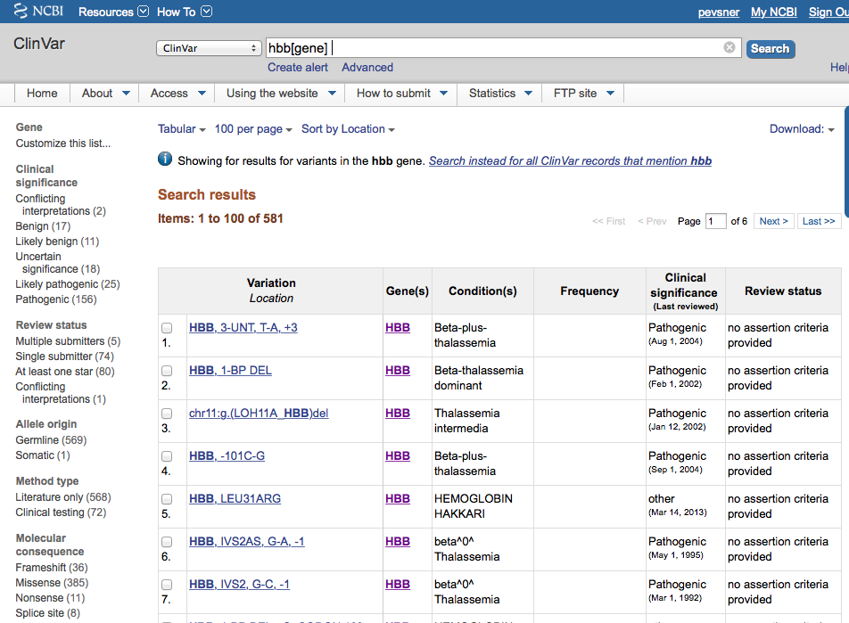
NCBI tools to understand variation: (2) ClinVar
ClinVar: result for “hbb”

Slide 28
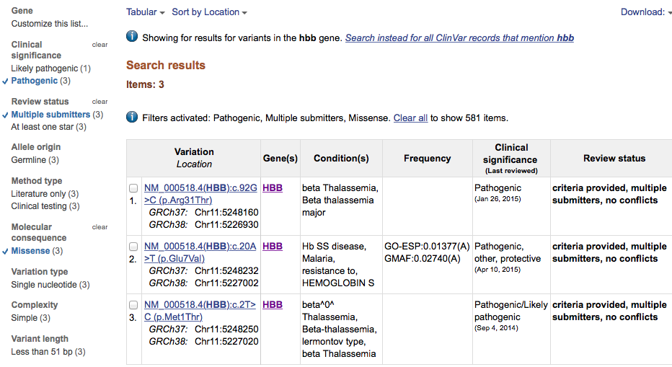
NCBI tools to understand variation: (2) ClinVar
ClinVar: use facets to limit results (here pathogenic, missense, multiple submitters)

Slide 29
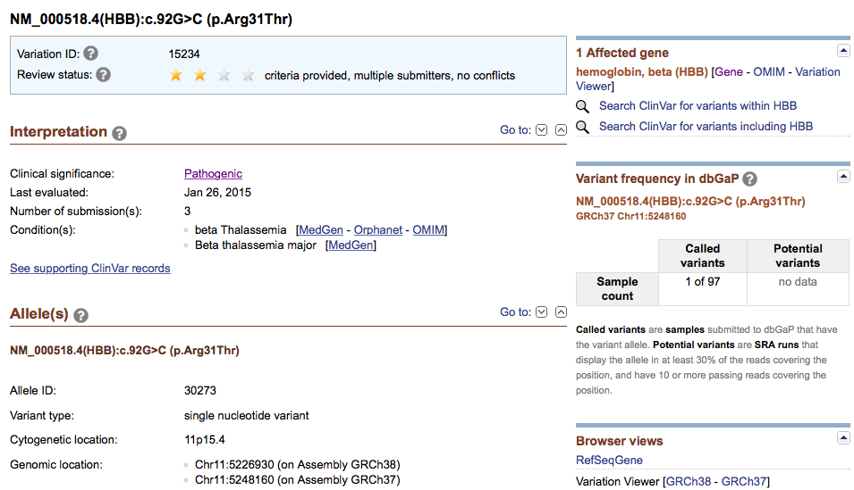
NCBI tools to understand variation: (2) ClinVar
ClinVar: details of mutant alleles
review status
interpretation, phenotype
Type of allele, location
Link to Variation Viewer
http://www.ncbi.nlm.nih.gov/clinvar/variation/15234/

Slide 30
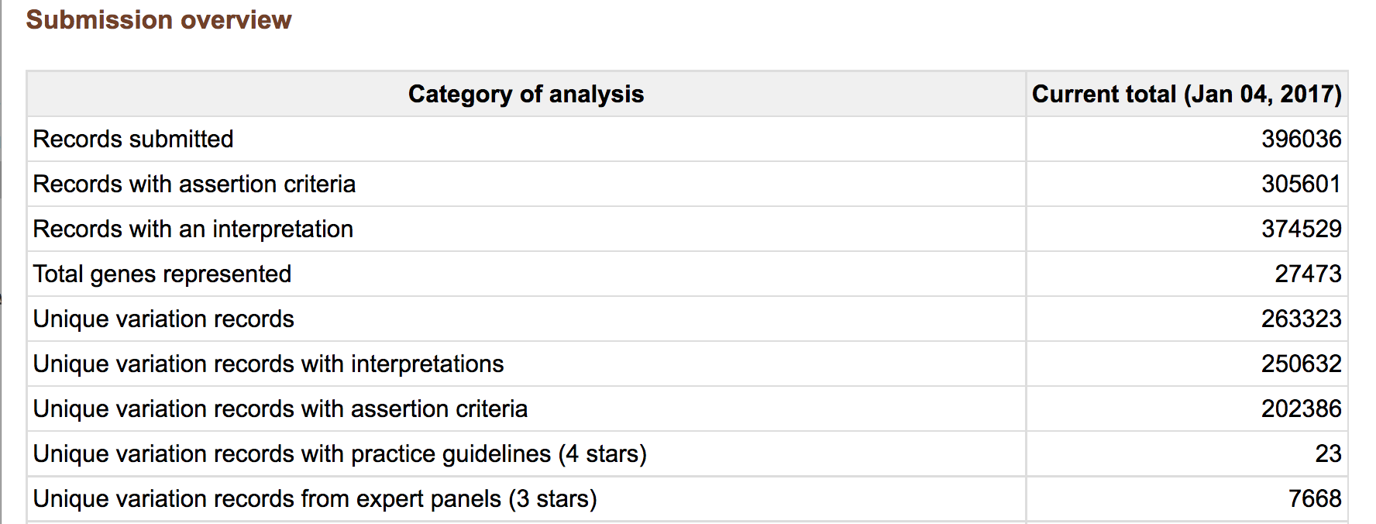
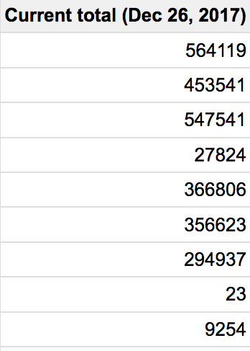
ClinVar STATISTICS

Slide 31
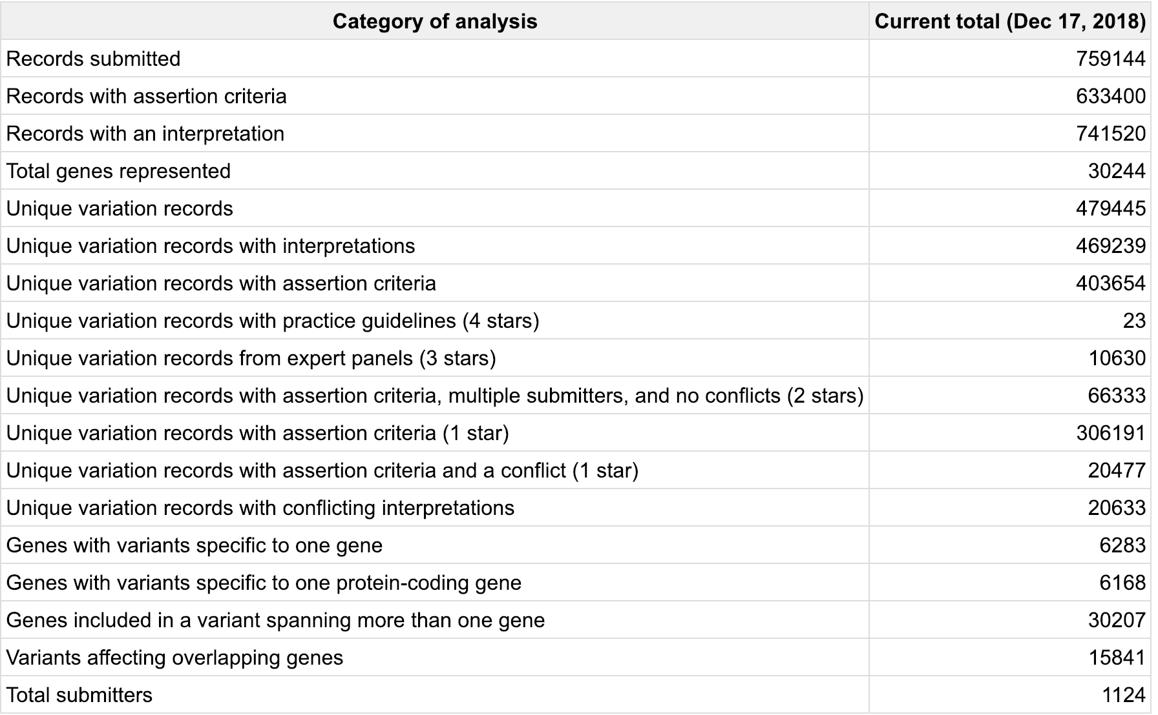
ClinVar Statistics www.ncbi.nlm.nih.gov/clinvar

Slide 32
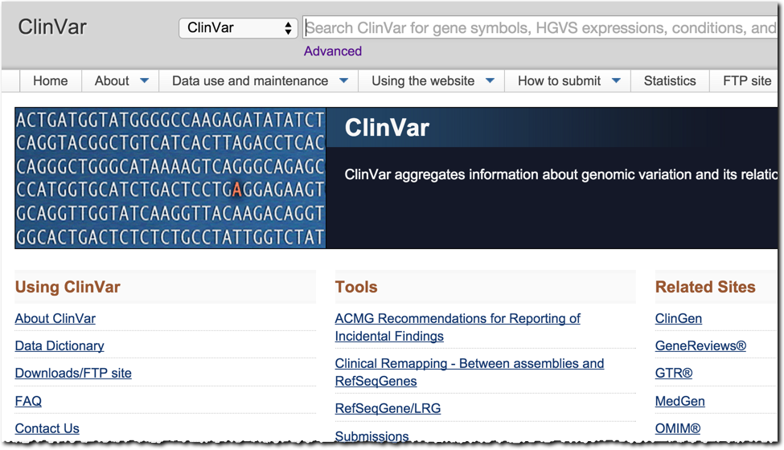
ClinVar – Gene Search
sod1

Slide 33
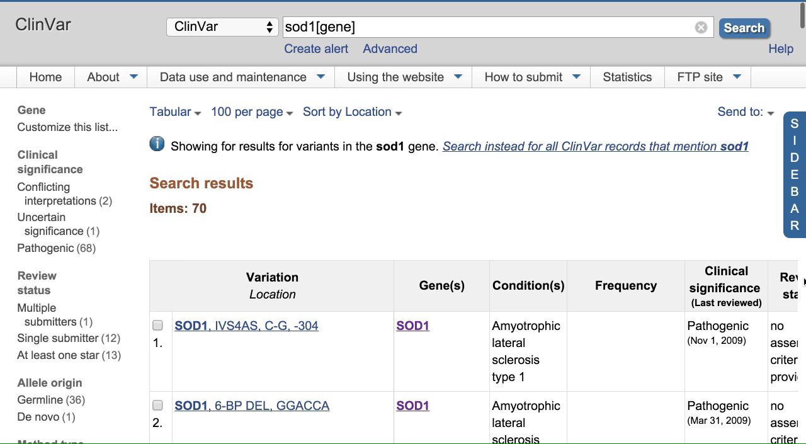
70 variants
dbSNP + dbVar

Slide 34
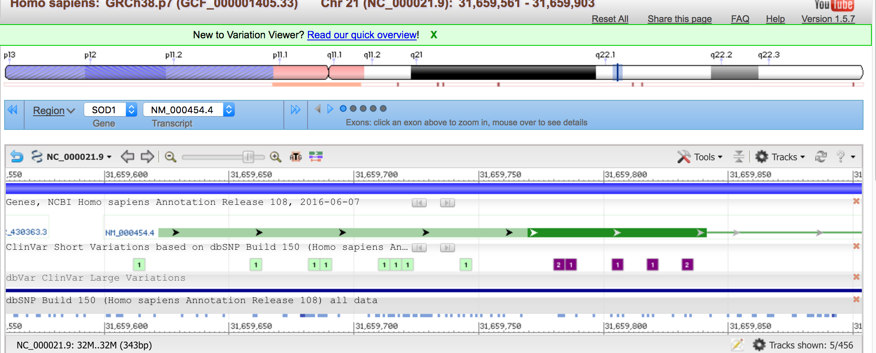
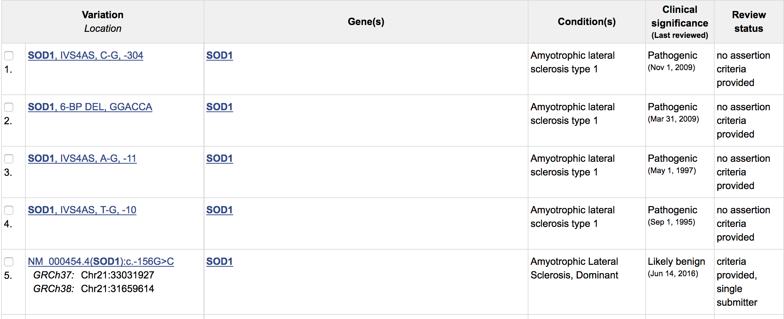

Slide 35
Task 3
Genes,
Variants
Disease
Molecular consequence?
MedGen
ClinVar
Clinical significance?

Slide 36
Task 4
Find Genetic tests
Disease or phenotype
Find Clinical Trials
GTR
Find Clinical Assertions
(ClinVar)

Slide 37
NIH Genetic Testing Registry
GTR
ClinicalTrials.gov
ClinVar

Slide 38
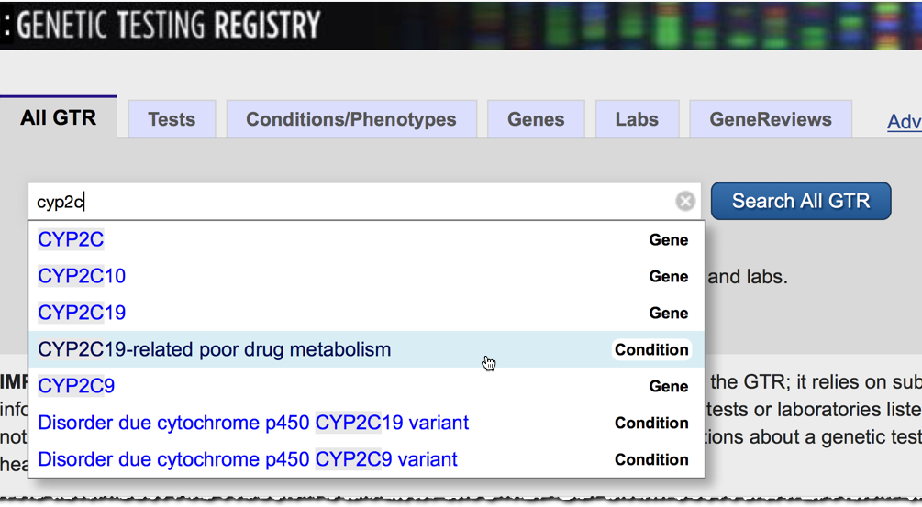
All GTR Search

Slide 39
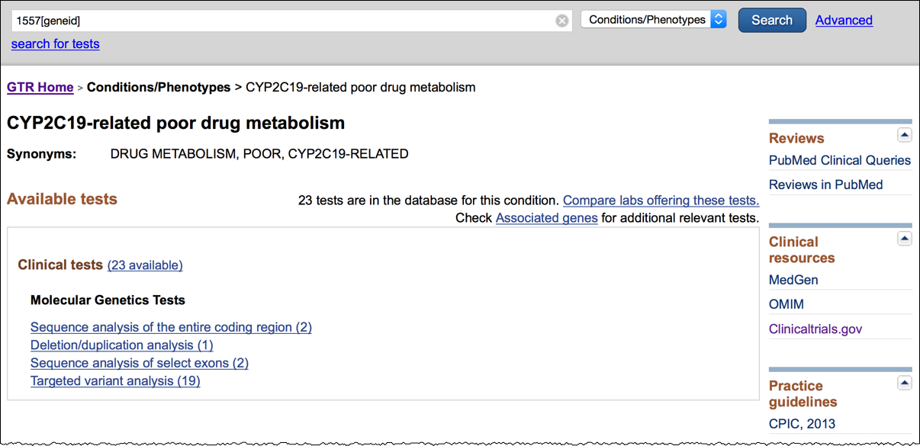
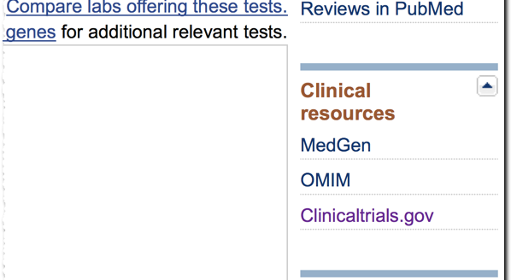
GTR ➔ Clinicaltrials.gov

Slide 40
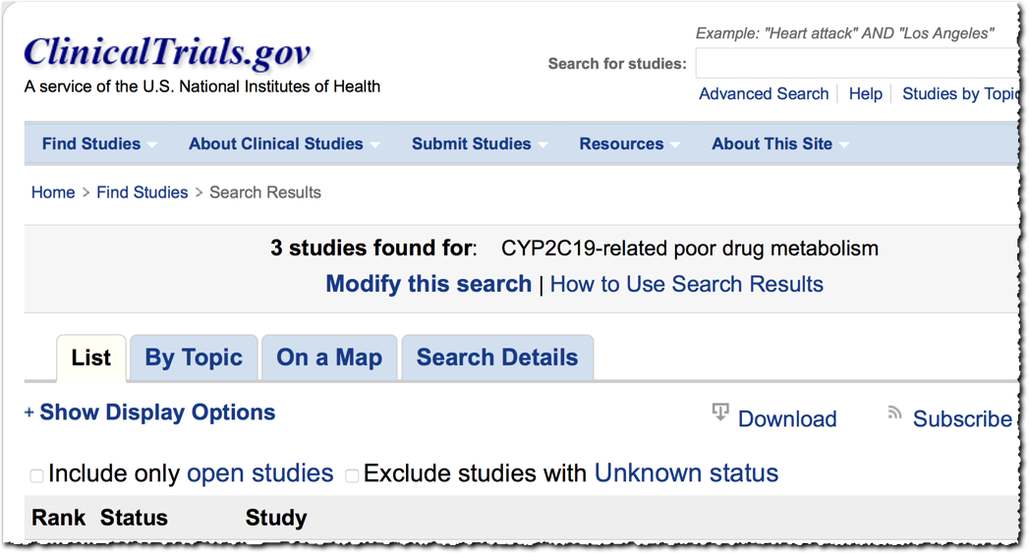
ClinicalTrials.gov

Slide 41
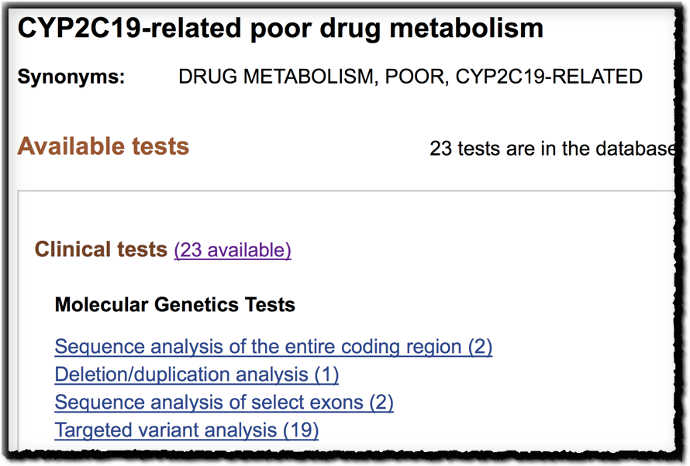

Slide 42
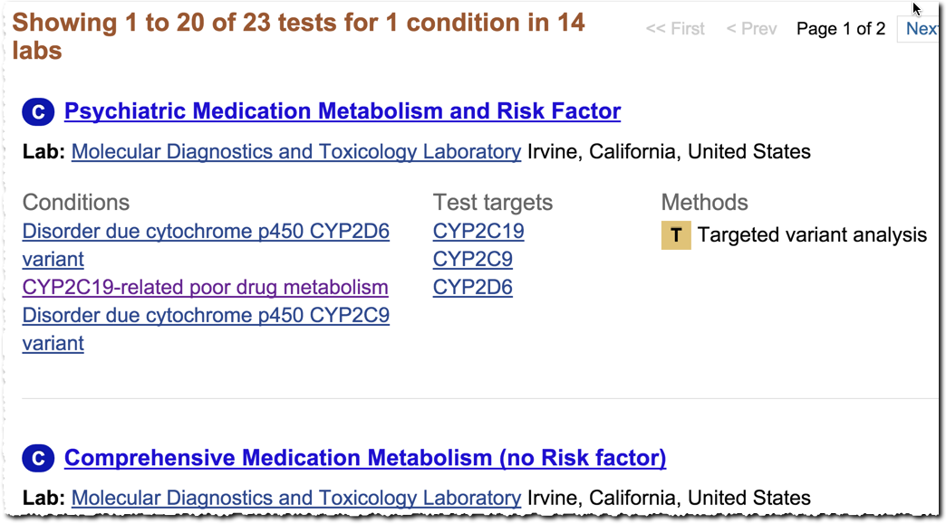
GTR – 23 Tests

Slide 43
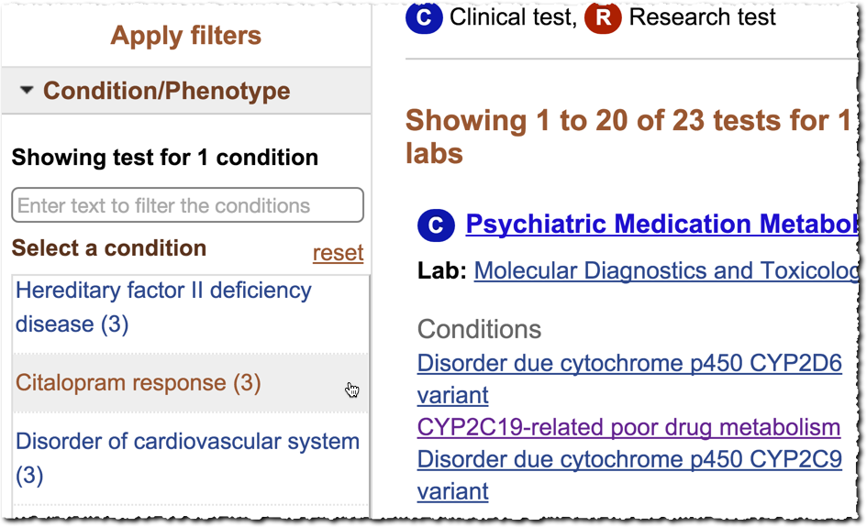
GTR – Condition Filter

Slide 44
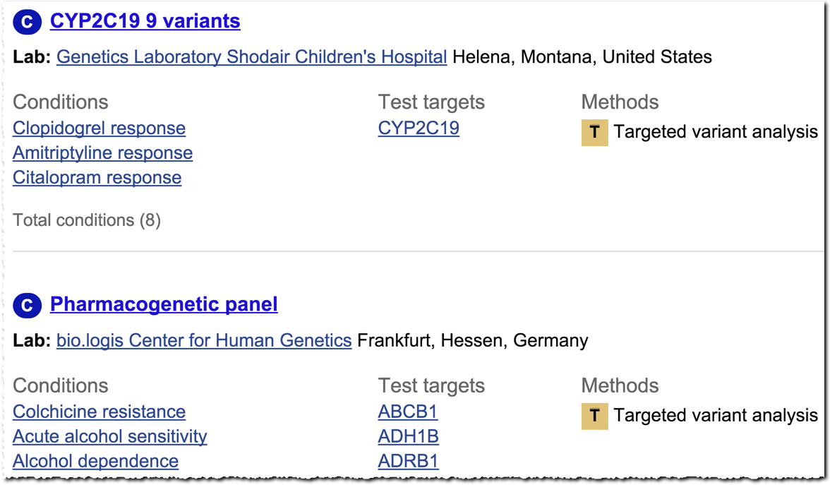
GTR – 3 Celexa Tests

